Slide 1

PREDICTING THE VERACITY OF JOB DESCRIPTIONS
CS675 005 Final Project
Paloma Almodovar Gonzalez, Anshul Shivhare, and Ram Yogesh Kolli

Slide 2
Exploratory Data Analysis

Slide 3
We performed in depth EDA, looking into every single variable instead of only some of them. This allowed us to determine which variables to use to train and test more basic models and which ones required NLP techniques.
Within the possible values of each categorical variable, we analyzed the distribution of fraudulent and real job postings. Thanks to this, we drew conclusions as to which variables provided relevant information and which ones could be irrelevant or even misleading.
Getting to know the data properly allowed us to follow appropriate techniques in the next parts of the project that improved accuracy.

Slide 4
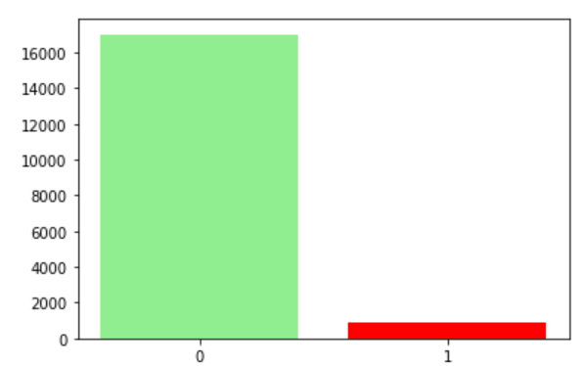
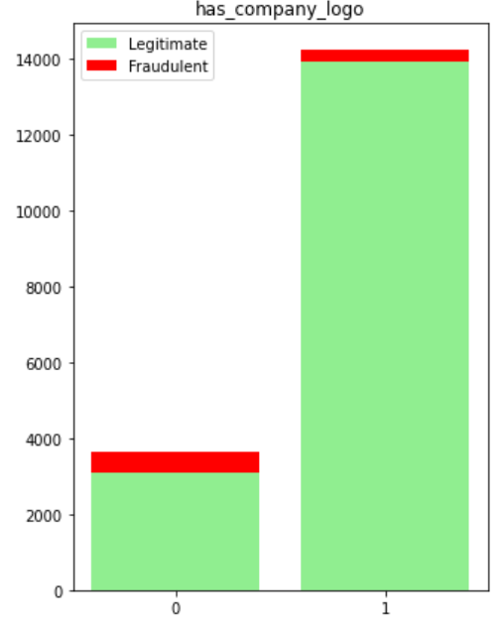
Fraudulent is the target variable of our dataset.
Looking at its distribution, we can immediately
tell that the dataset is extremely imbalanced.
Therefore, we’ll have to apply techniques like
SMOTE in later steps of the project.
Has Company Logo The number of companies
without a logo is much smaller than the ones that
have one. However, the 20.47% of companies
without a logo accounts for 67.32% of the total
fraudulent job postings. Therefore, this variable
Will provide a lot of relevant information.

Slide 5
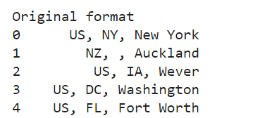
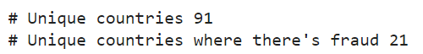
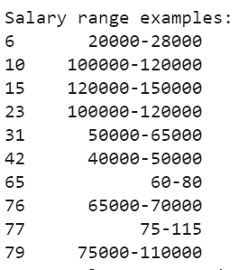
Location had missing information and a format
that wasn’t ideal for classification. Therefore,
we cleaned the data to only reflect the country.
We concluded that this variable would be useful but
we had to be cautious of the weight we assigned to it.
Salary Range We can see that 83.96% of the job
postings don’t have a salary range. This percentage
accounts for 74.25% of the fraudulent postings.
Furthermore, looking at some of the salary range
values, we noticed that the formatting wasn’t consistent.
We decided this variable could potentially be misleading.

Slide 6
Classification models and assessment

Slide 7
Feature Selection
In this part, we are focussing mainly on selecting the best features of the dataset that was provided.
We mainly focussed on categorical features present in our dataset.
Based on some assumptions from EDA, we went through various experiments on selecting desired features and used them on the model classification.
After comparing the results of the performances of the Models, we came to conclusion on selecting the features.
Also, here we used confusion matrix as a performance criterion due to imbalance in the dataset.

Slide 8
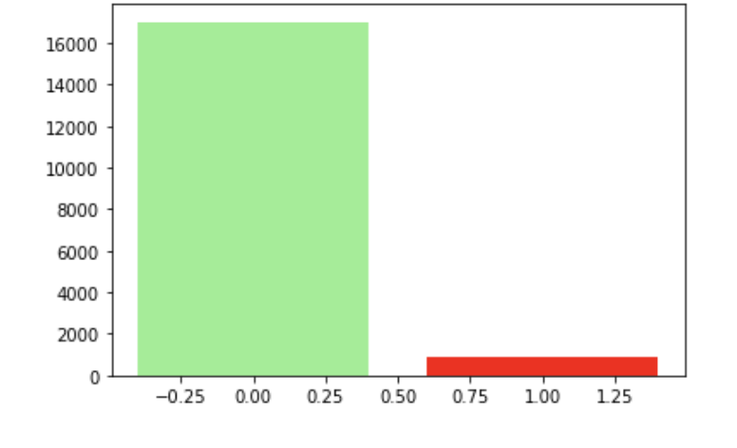
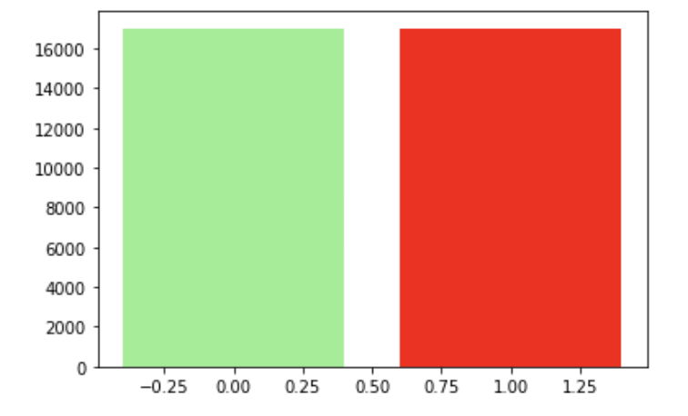
Balancing dataset
Before starting the feature selection or doing any experiments on performances of models, the dataset of this project was imbalance.
So, in order to balance the dataset, we performed SMOTE on the dataset and compared the dataset of balanced and imbalanced.
SMOTE generally works by generating new instances from existing minority cases that supplied as an input.
After the dataset was balanced, we proceeded further on comparing results of different classifiers.
Before applying SMOTE on dataset
After SMOTE applied

Slide 9
Models Used
Logistic Regression.
Random Forest Classifier.
XGBoost classifier.
During this part, we used three models to check the classification performance when experimenting on features.

Slide 10
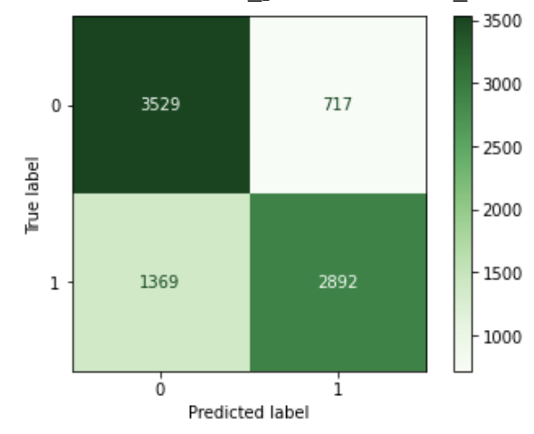
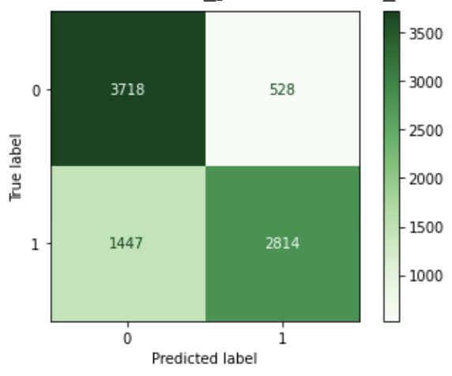
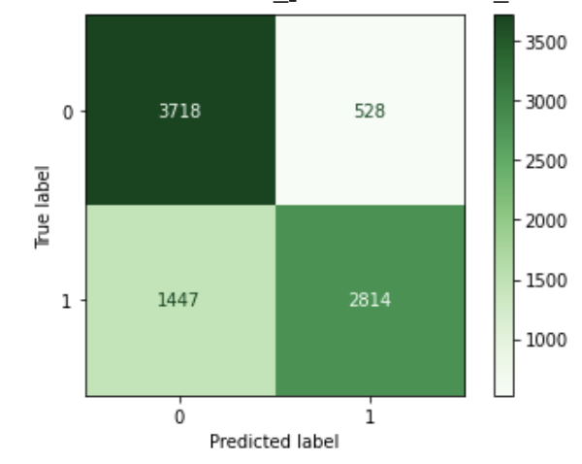
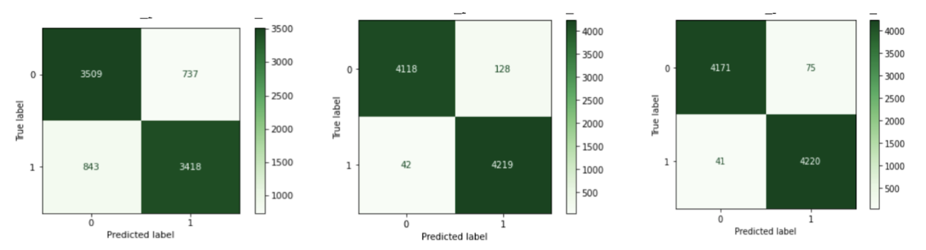
Feature selection
At first we compared the results of different model performances by using different combinations of features.
After some experiments, we came to the conclusion that all the features provided in the dataset were useful and gave the best performance when all the features were used.
Logistic Regression
Random Forest Classifier
XGBoost Classifier
Performances when some features were considered
Logistic Regression
Random Forest Classifier
XGBoost Classifier
Performances when all the features were considered

Slide 11
Final comparison of Model performances
After selecting the features, we performed classification using the three models(Logistic Regression, Random Forest classifier, and XGBoost classifier)
Out of these, XGBoost classifier gave the best predictions in classifying the data.
The accuracy score of the XGBoost classifier was also good when compared to the other models.
Logistic Regression
Random Forest Classifier
XGBoost Classifier
The accuracy scores of these models were:
Logistic Regression: 81.43%
Random Forest Classifier: 98%
XGBoost Classifier: 98.64%

Slide 12
Natural Language Processing

Slide 13
NLP
Language Detection
Tokenization: Converting Sentences to Array of Words Involved.
Stemming: Stemming converts the words to there most basic form. Ex: connections, connected, connects will become “connect”.
Removing Stop Words: Stop words don’t add any meaning to the sentence like “is”, “the” etc.
Text Cleaning
Replacing Numbers with Empty Character
Replacing Characters like -, _, etc with Empty Character
Replacing Links (http and https) with Empty Character
Replacing Short Hands with there Full Forms. Example: ‘ve with have, I’m with I am, etc.
Steps
Library Used: NLTK (Natural Language ToolKit)

Slide 14
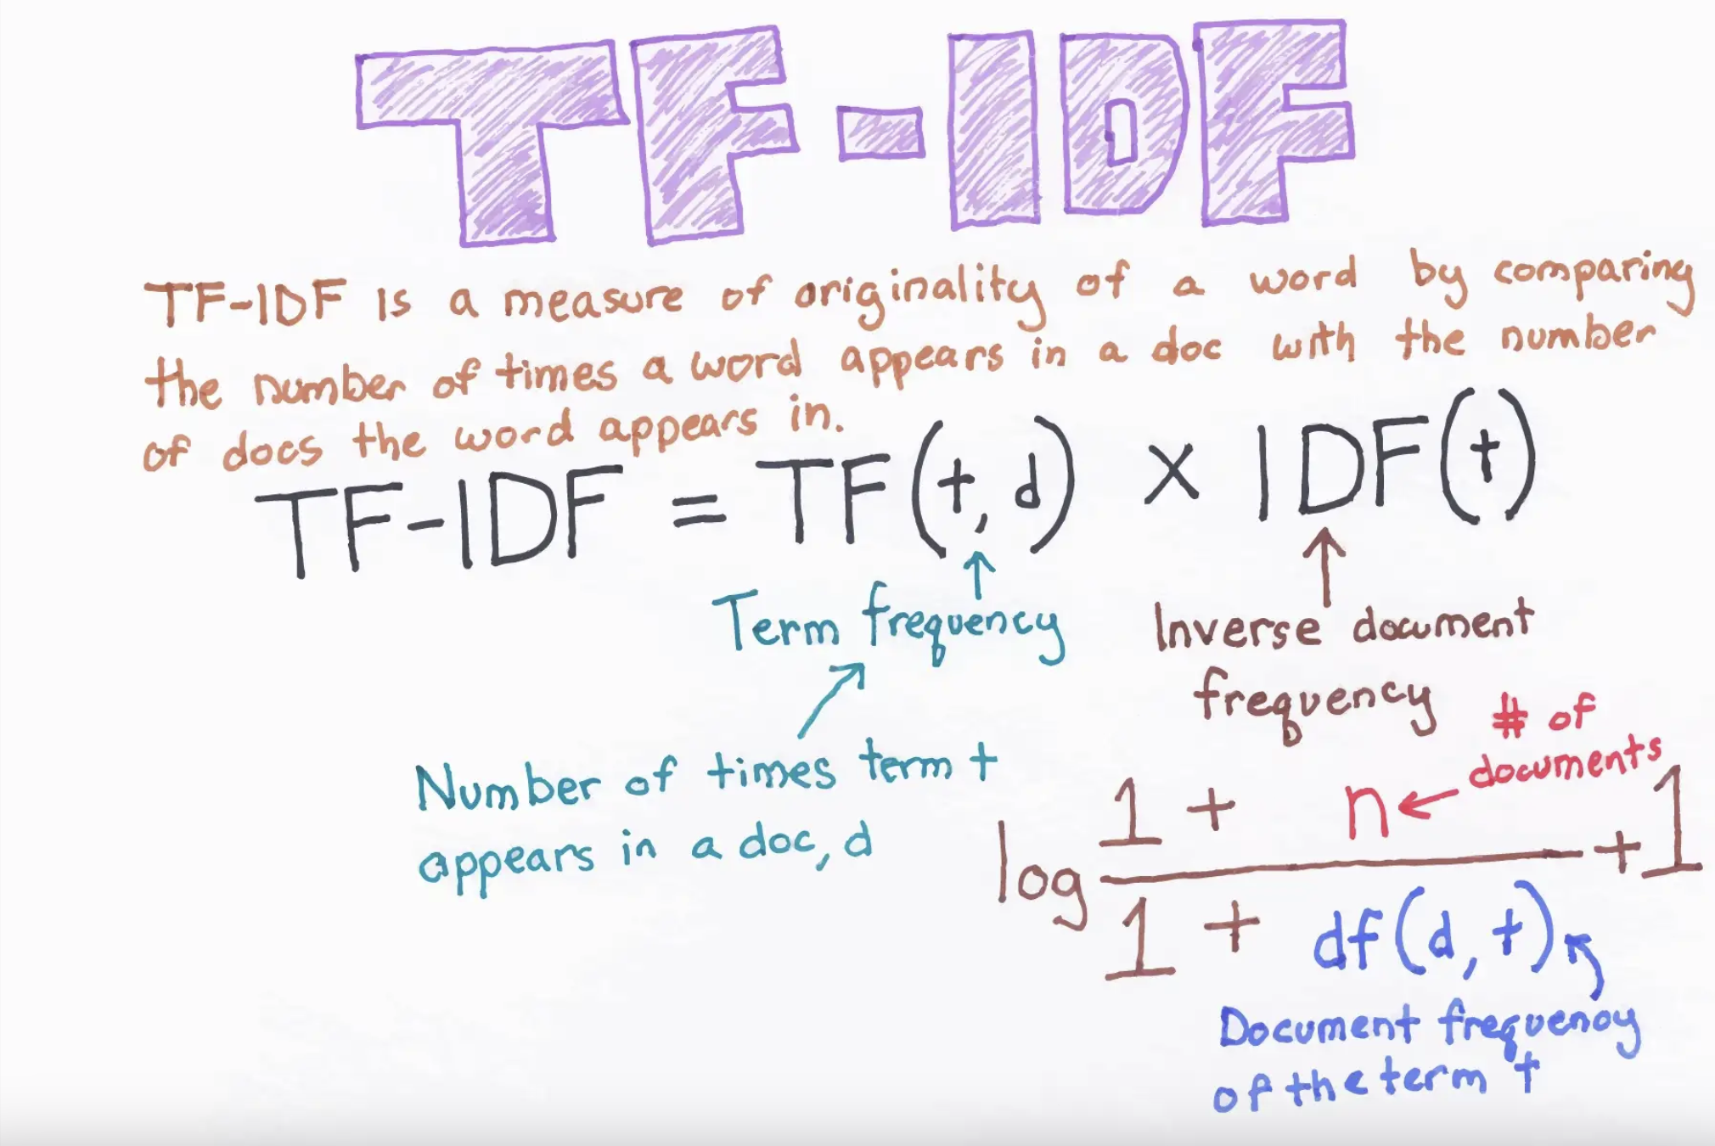
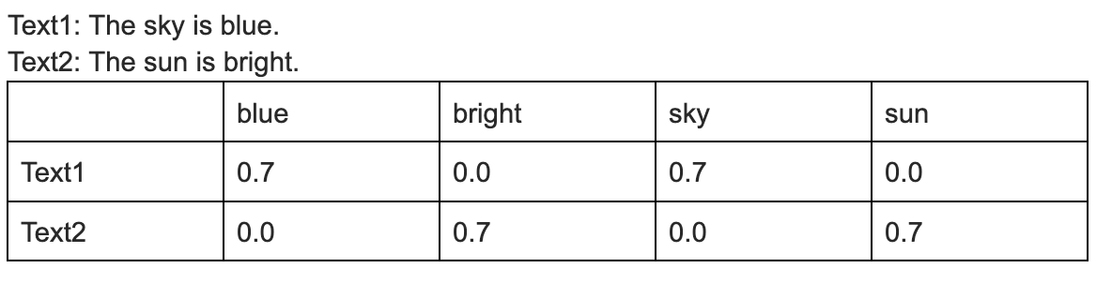
Data Preparation
Instead of having Text in different columns, we appended all available text to a Single Column. Converting multiple detail deficient features into a single detail rich Text Column.
TF-IDF (Term Frequency - Inverse Document Frequency) Vectorization: This step is crucial step for our project. We are converting text data into numerical features. Reference Medium Article: https://medium.com/@cmukesh8688/tf-idf-vectorizer-scikit-learn-dbc0244a911a
Addressing Data Imbalance: Using SMOT which is Synthetic Minority Oversampling Technique. This uses KNN algorithm to find the neighbours over oversampling.

Slide 15
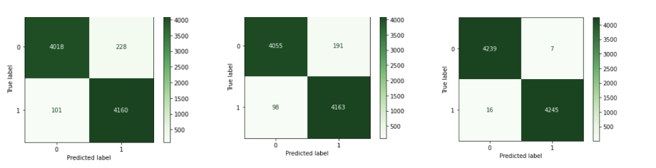
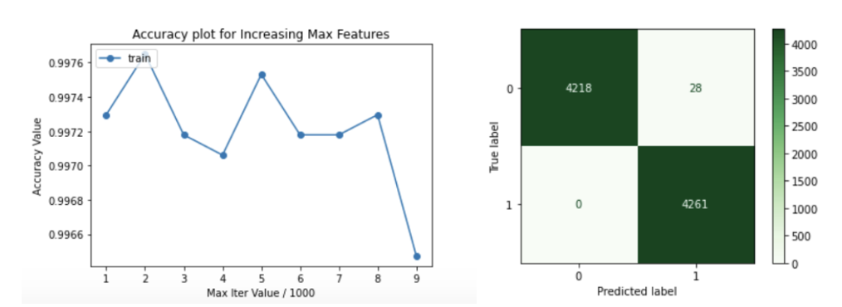
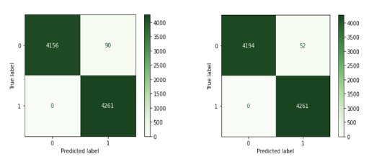
Classification Models (Text Data)
We opted for Confusion Matrix as a reference for the performance of the model and not the accuracy due to less data points for Fraudulent Jobs.
L to R: Logistic Regression, Decision Trees, Random Forest
MLP Classifier (Left: LBFGS, Right: Adam)
Hyperparameter Tuning
For restraining the Scope of the Project, we picked only our best Model i.e. MLP Classifier with Adam Solver.
Optimizing Max Features from TF-IDF Vectorizer
Optimizing MLP using GridSearchCV from SKLearn

Slide 16
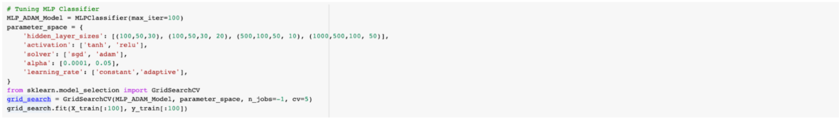
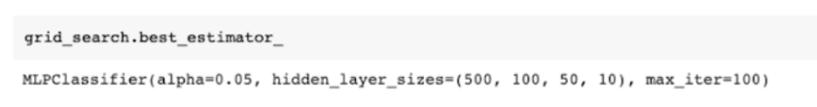
GridSearchCV Code (For Reference)

Slide 17
Model Ensembling

Slide 18
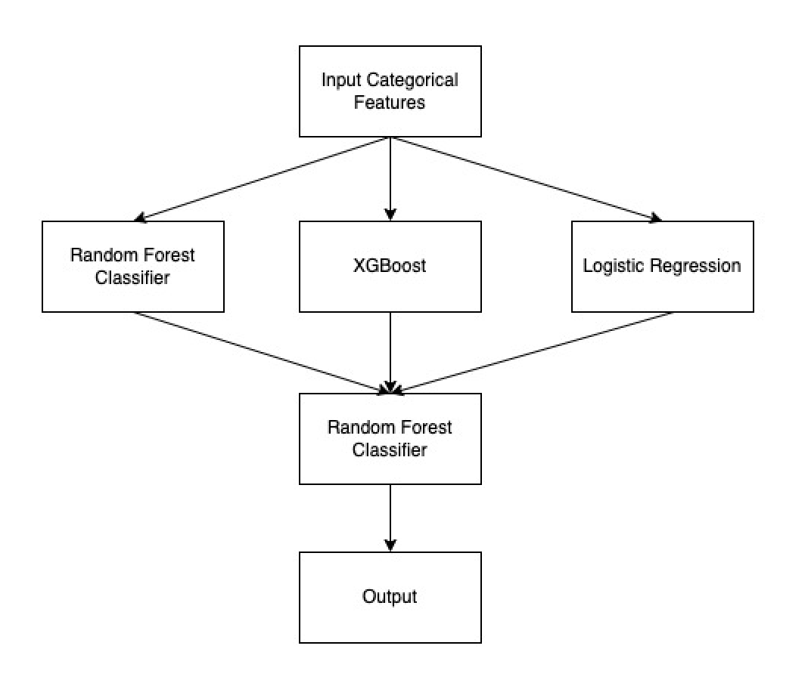
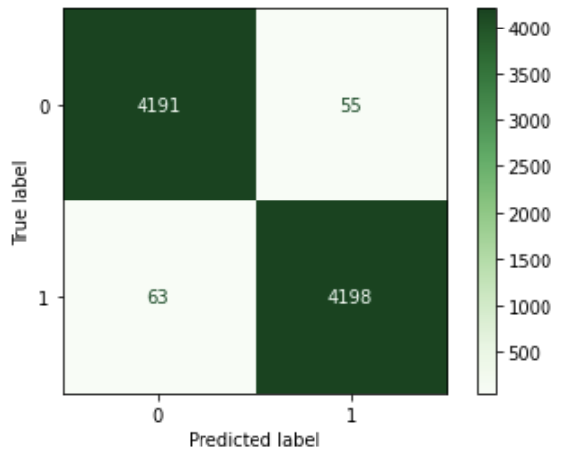
Stacking
Model Stacking is a technique in which we can train multiple classification models together and the results of it we can use to train a final model.
Stacking Models trained on Categorical Data
Confusion Matrix for the Final Model
Our Stacking Structure

Slide 19
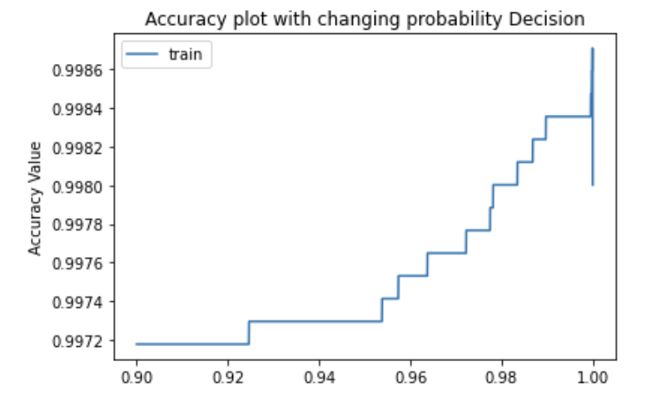
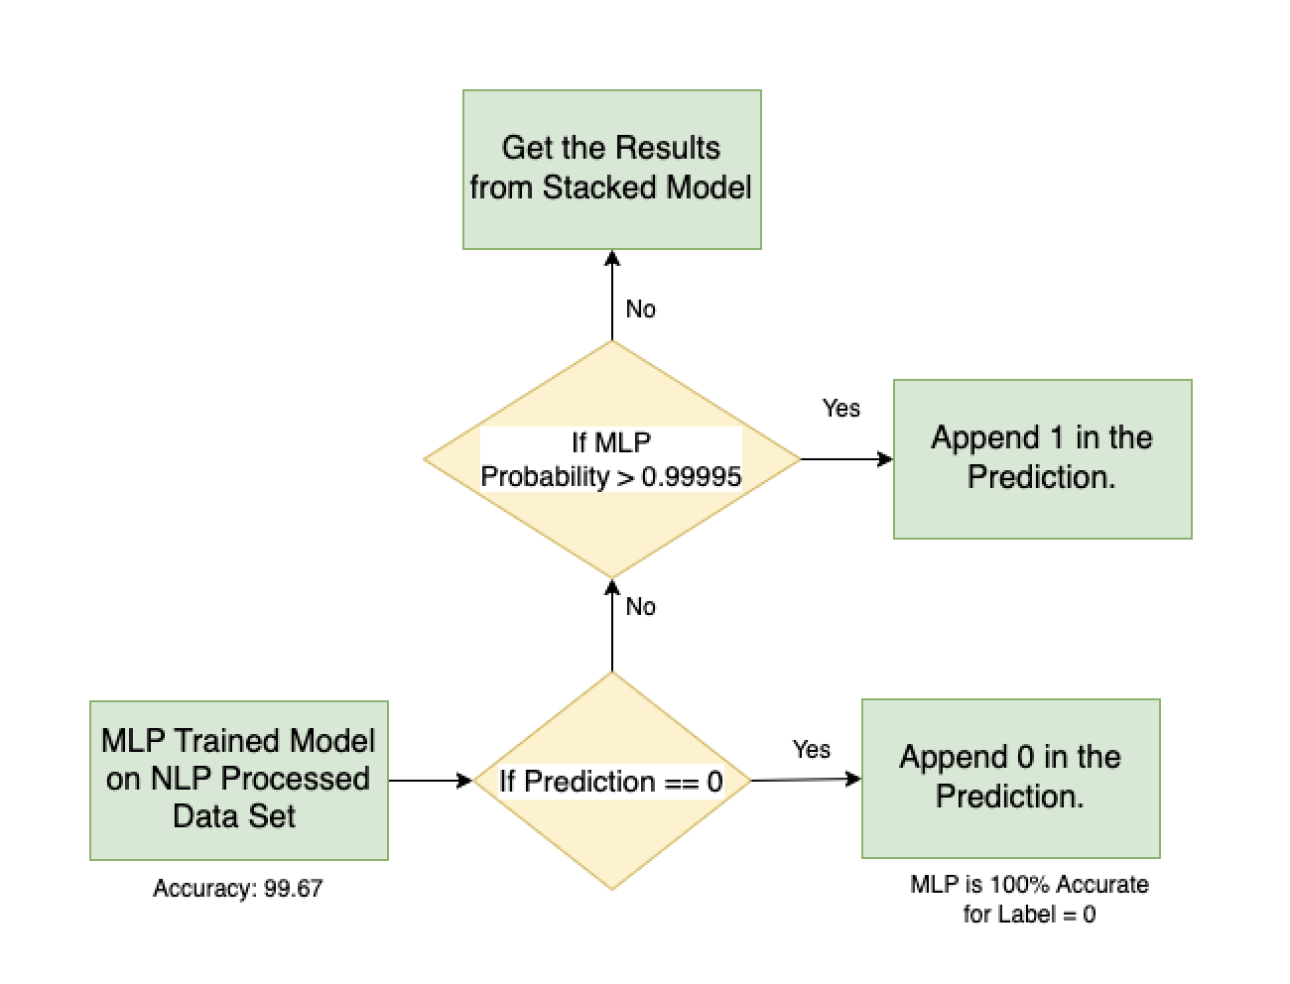
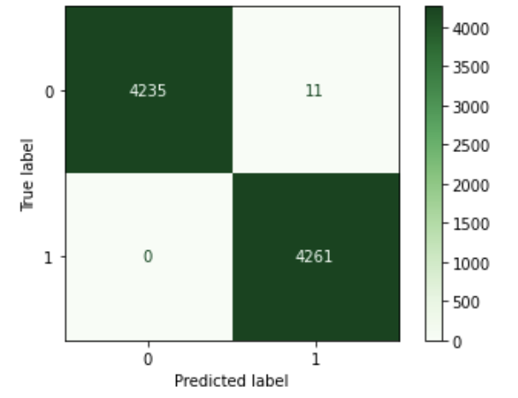
Ensembling Models from Categorical Features and Text Features
Hypertuning the Probability Percentage
Accuracy and Confusion Matrix
Accuracy Percentage
99.89%

